Slide 1


Bhavik vyas

Slide 2
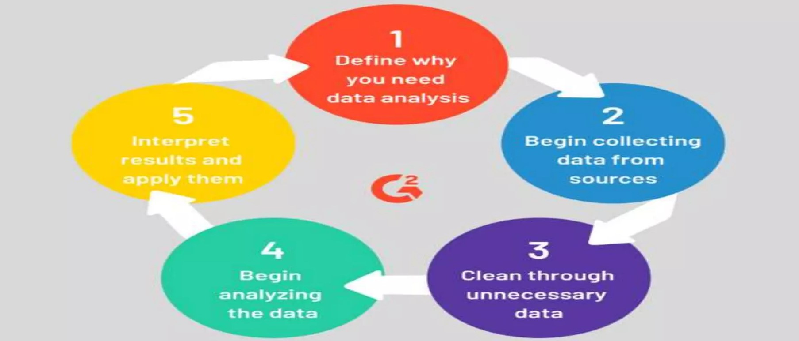
What is Data ?
What is Analytics ?
Data is simply facts or figures - bits of information.
When data is organized, processed, interpreted, structured to make it meaningful or useful, it is called complete information.
Data can be images, sounds, videos etc.
Data is measured, reported, and analyzed
can be structured or unstructured
can be discrete or continuous
It is the method of understanding or identifying or interpreting the hidden pattern in the data for effective . decision making.
STEPS OF DATA ANALYTICS
What is Data Analytics ?
It is the process of inspecting, cleaning, transforming and modelling data by using statistics

Slide 3
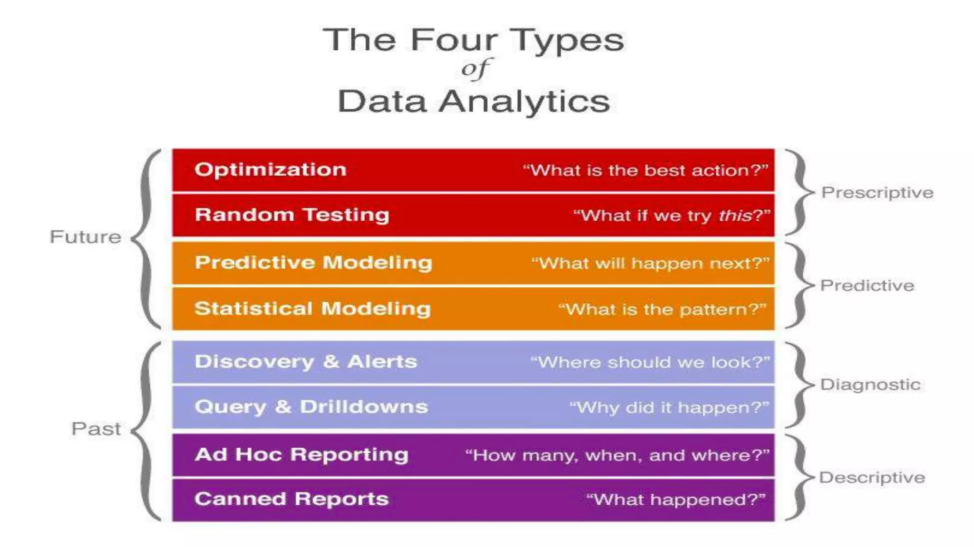

Slide 4
Types of
Data Analytics
Data analytics is broken down into four basic types.
Descriptive analytics: This describes what has happened over a given period of time. Have the number of views gone up? Are sales stronger this month than last?
Diagnostic analytics: This focuses more on why something happened. This involves more diverse data inputs and a bit of hypothesizing. Did the weather affect icecream sales? Did that latest marketing campaign impact sales?
Predictive analytics: This moves to what is likely going to happen in the near term. What happened to sales the last time we had a hot summer? How many weather models predict a hot summer this year?
Prescriptive analytics: This suggests a course of action. If the likelihood of a hot summer is measured as an average of these five weather models is above 58%, we should add an evening shift to the brewery and rent an additional tank to increase output.

Slide 5
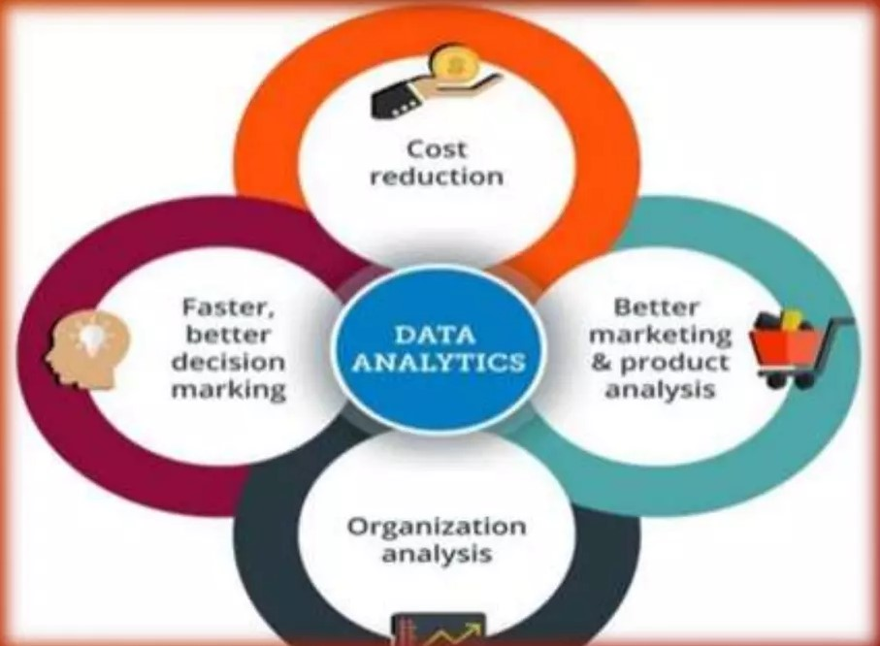
Why Data Analytics
Effective decision making
Enhanced customer service
Improves Business/sales
Identify anomalies

Slide 6
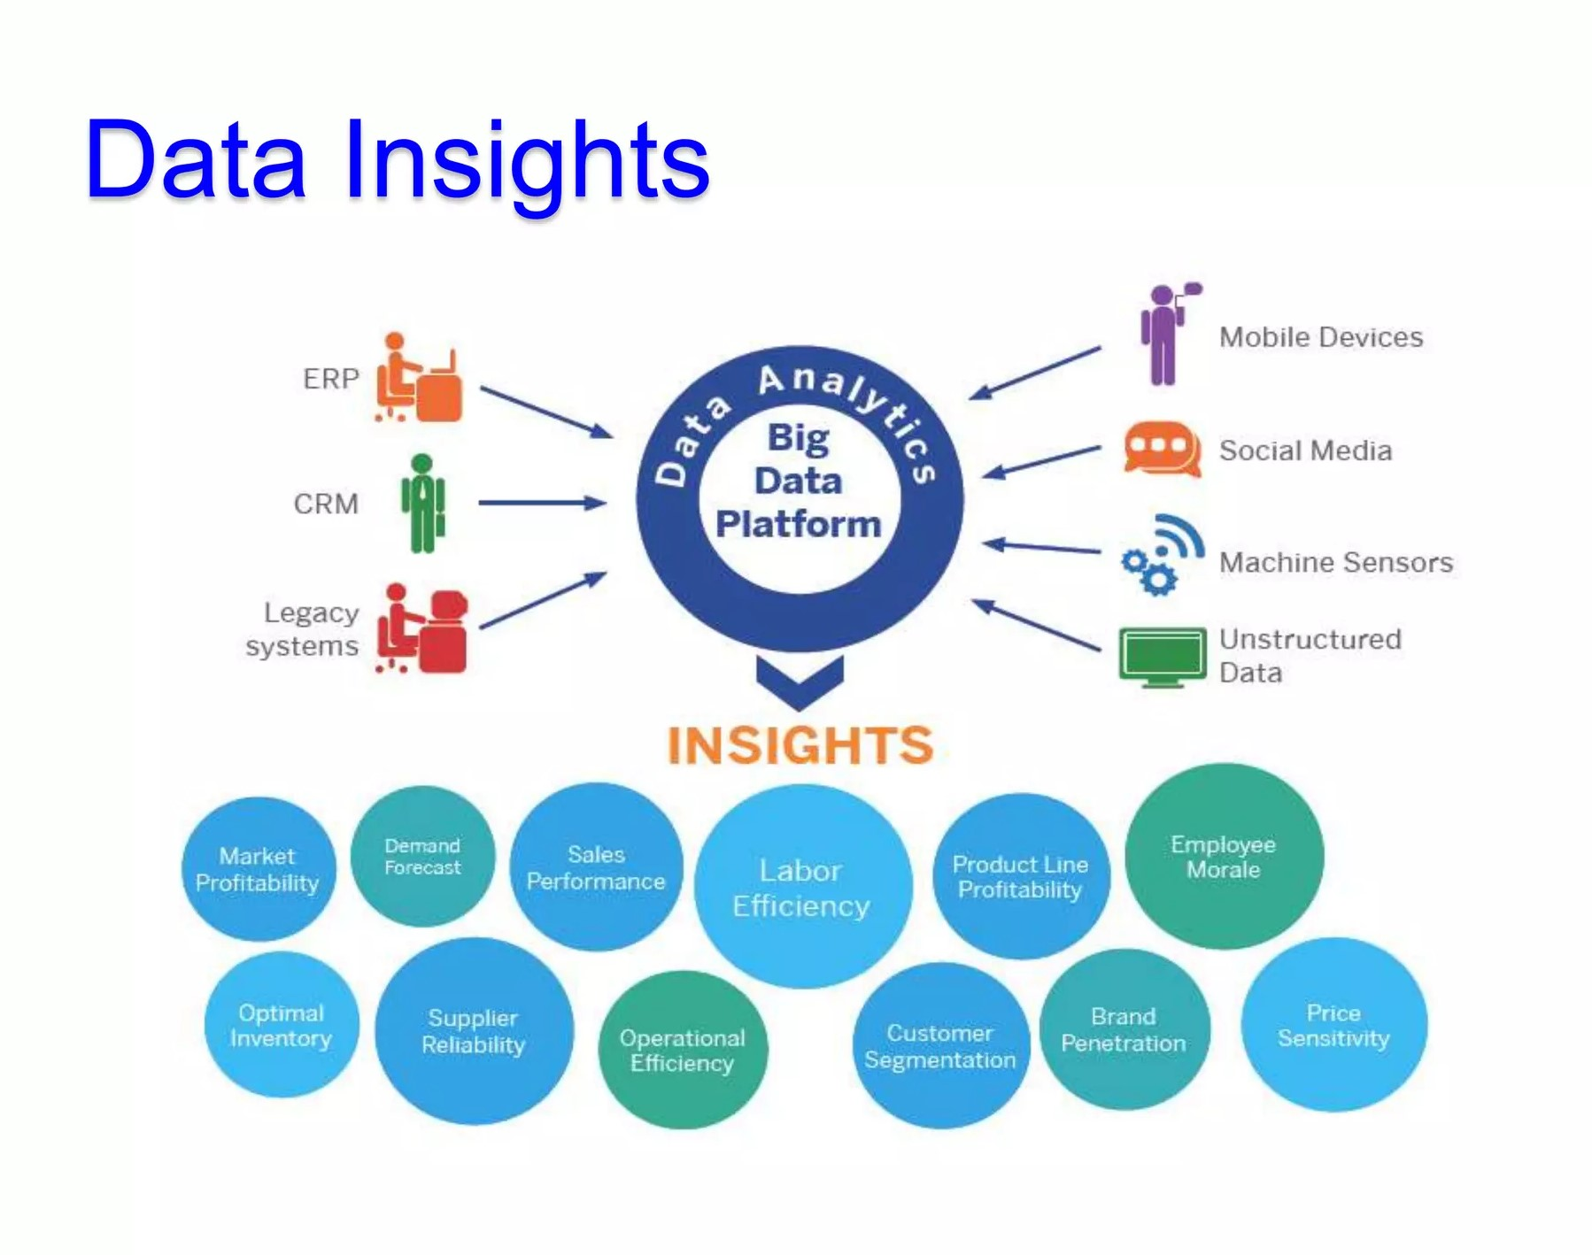

Slide 7
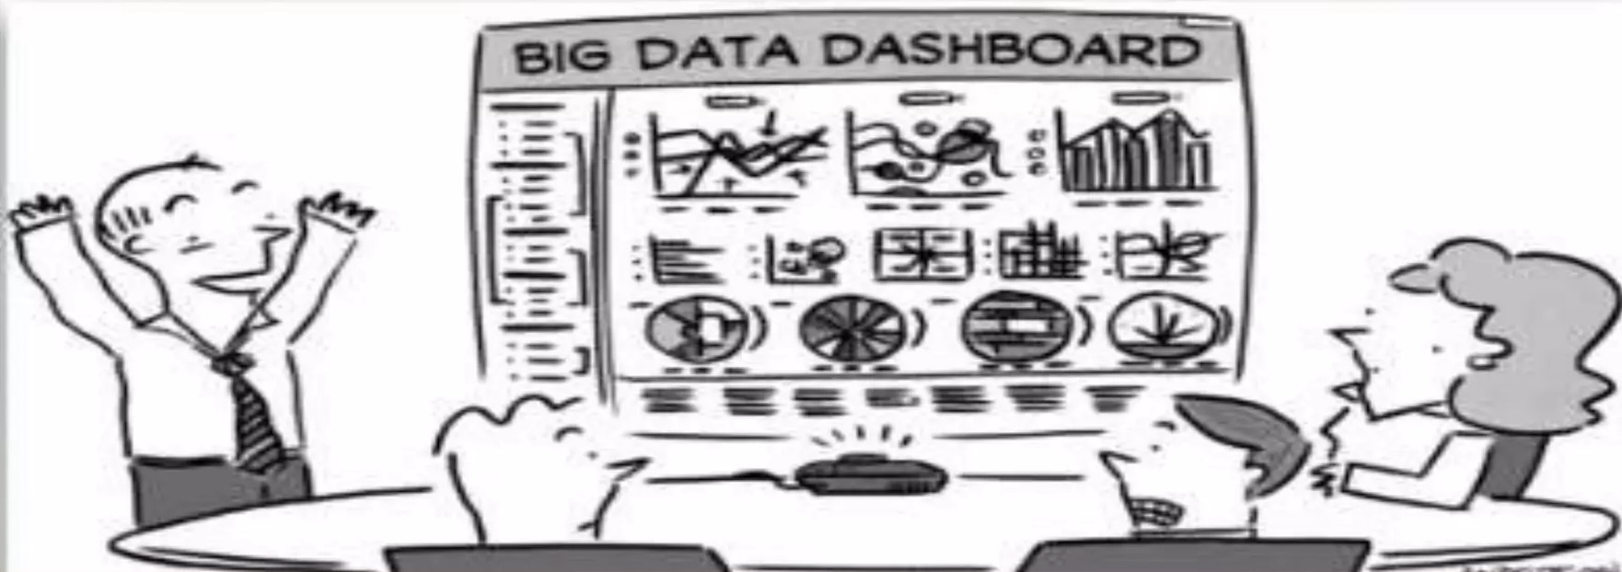
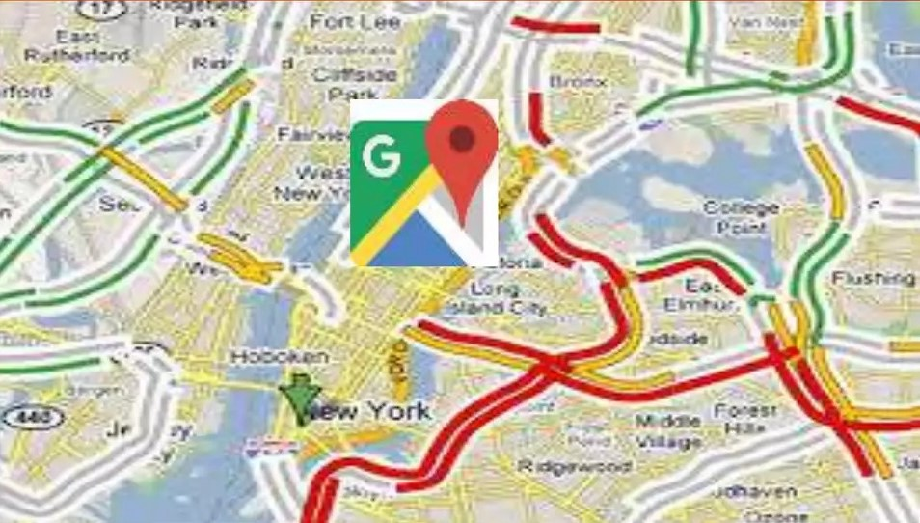

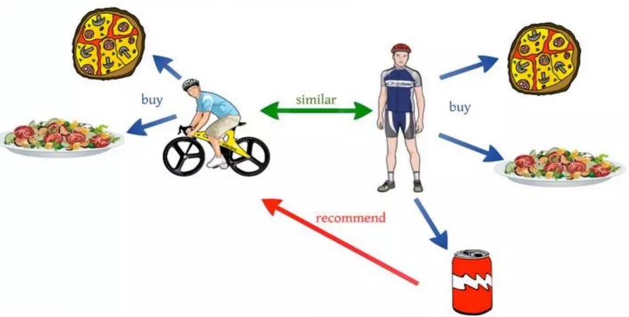

Applications of Data Analytics
Decision Making
Google Maps
Self Driving Cars
Recommendation Engine
Games

Slide 8
Activities in Data Analytics
Data Extraction - Fetch data from database
Data Analysis - Observe the data
Data Manipulation - Manipulate the data
Data Modelling - Fit a model to the data
Data Visualization - Visualize the data

Slide 9
Tools available in Data Analytics
Data Analysis & Modelling
Data visualization
SQL
Statistica
MS Excel
Power BI
Excel

Slide 10
Thank You

